Slide 1
Session 1
Computing paradigm and introduction to Cloud Computing

Slide 2
Objectives
Computing Paradigms
Cloud computing definition
Cloud computing essential characteristics
Cloud computing deployment models
Cloud computing service models

Slide 3
Preamble
The term paradigm conveys that there is a set of practices to be followed to accomplish a task
In the domain of computing, there are many different standard practices being followed based on inventions and technological advancements.

Slide 4
Client/Server Model
In the client/server model, all end systems are divided into clients and servers each designed for specific purposes
Clients have an active role and initiate a communication session by sending requests to servers
Clients must have knowledge of the available servers and the services they provide
Clients can communicate with servers only; they cannot see each other
Servers have a passive role and respond to their clients by acting on each request and returning results

Slide 5
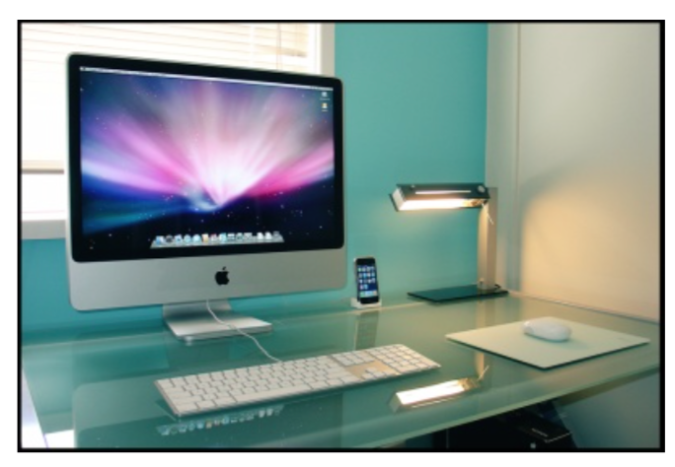
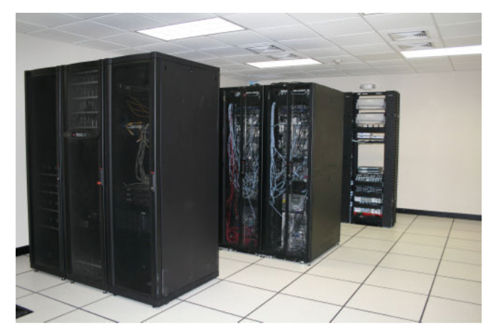
Client/Server Model (cont’d)

Slide 6
Client/Server Model (cont’d)
Software roles
TCP/IP uses different pieces of software for many protocols to implement ”client” and ”server” roles
Client software is usually found on client hardware and server software on server hardware, but not always
Some devices may run both client and server software
Web clients:
Mozilla Firefox, Internet Explorer, Google Chrome, . . .
Web servers:
Apache, Microsoft IIS, GWS, . . .

Slide 7
P2P Model
In the P2P model, all end systems have equivalent capabilities and responsibilities and either party can initiate a communication session
The participants share a part of their own hardware resources
Thus, the participants are both resource providers and resource requestors and use similar networking programs to connect with each other

Slide 8
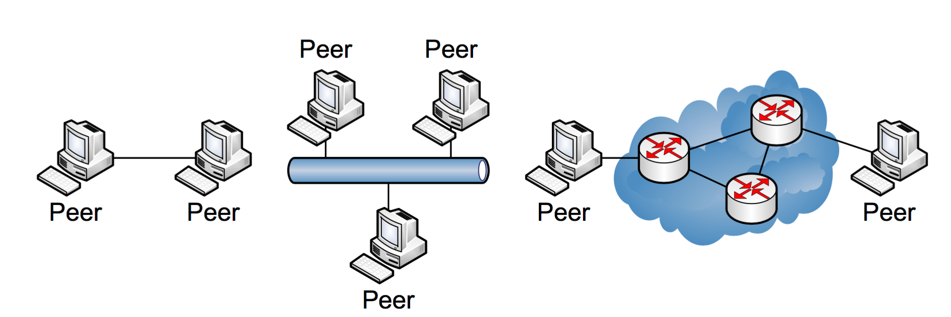
P2P Model (cont’d)

Slide 9
P2P Model (cont’d)
Benefits of P2P:
No need for dedicated application and database servers
Improved scalability and reliability (no single point of failure)
Shortcomings of P2P:
Poor security
Lack of centralized control
Computers with shared resources may suffer from sluggish performance
P2P networking allows easily to share and download copyrighted files
Is it a benefit or a shortcoming? :-)

Slide 10
High-Performance Computing
In high-performance computing systems, a pool of processors (processor machines or central processing units [CPUs]) connected (networked) with other resources like memory, storage, and input and output devices, and the deployed software is enabled to run in the entire system of connected components.
The processor machines can be of homogeneous or heterogeneous type.
HPC systems are normally found in those applications where it is required to use or solve scientific problems.

Slide 11
Parallel Computing
Parallel computing is also one of the facets of HPC
It is run using multiple processors (multiple CPUs)
A problem is broken down into discrete parts that can be solved concurrently
Each part is further broken down into a series of instructions
Instructions from each part are executed simultaneously on different processors
An overall control/coordination mechanism is employed

Slide 12
Distributed Computing
Distributed computing is also a computing system that consists of multiple computers or processor machines connected through a network, which can be homogeneous or heterogeneous, but run as a single system
The goal of distributed computing is to make such a network work as a single computer
There is a support for the following characteristic features
Scalability: It is the ability of the system to be easily expanded by adding more machines as needed, and vice versa, without affecting the existing setup
Redundancy or replication: Here, several machines can provide the same services, so that even if one is unavailable (or failed), work does not stop because other similar computing supports will be available.

Slide 13
Cluster Computing
A cluster computing system consists of a set of the same or similar type of processor machines connected using a dedicated network infrastructure.
This is also a kind of HPC category.
The individual nodes can work together to solve a problem larger than any computer can easily solve

Slide 14
Grid Computing
Grid computing is a network of computing or processor machines managed with a kind of software such as middleware, in order to access and use the resources remotely.
The managing activity of grid resources through the middleware is called grid services
Grid services provide access control, security, access to data including digital libraries and databases, and access to large-scale interactive and long-term storage facilities
Notes:
The computing resources in most of the organizations are underutilized but are necessary for certain operations. The idea of grid computing is to make use of such nonutilized computing power by the needy organizations, and thereby the return on investment (ROI) on computing investments can be increased.

Slide 15
Cloud Computing
In the simplest terms, cloud computing means storing and accessing data and programs over the Internet from a remote location or computer instead of our computer’s hard drive.
The cloud is just a metaphor for the Internet
With an online connection, cloud computing can be done anywhere, anytime, and by any device.

Slide 16
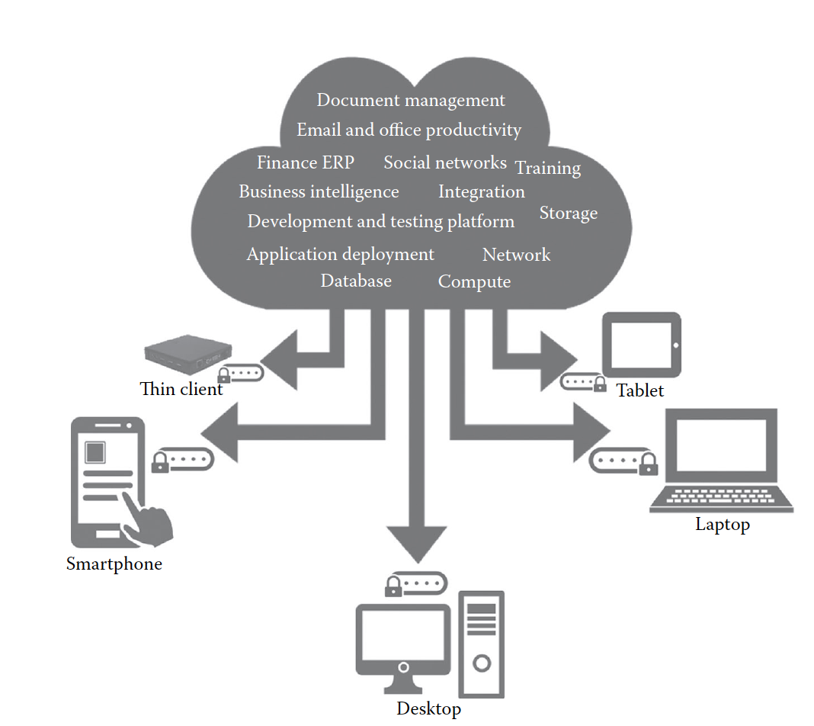
Cloud Computing(continue)

Slide 17
Five Essential Characteristics
On-demand self-service: A consumer can unilaterally provision computing capabilities, such as server time and network storage, as needed automatically without requiring human interaction with each service’s provider.
Broad network access: Capabilities are available over the network and accessed through standard mechanisms that promote use by heterogeneous thin or thick client platforms
Elastic resource pooling: The provider’s computing resources are pooled to serve multiple consumers using a multitenant model

Slide 18
Five Essential Characteristics
Rapid elasticity: Capabilities can be rapidly and elastically provisioned, in some cases automatically, to quickly scale out and rapidly released to quickly scale in
Measured service: Cloud systems automatically control and optimize resource use by leveraging a metering capability at some level of abstraction appropriate to the type of service

Slide 19
Four Cloud Deployment Models
Deployment models describe the ways with which the cloud services can be deployed or made available to its customers, depending on the organization structure and the provisioning location.
Four deployment models are usually distinguished, namely, public, private, community, and hybrid cloud service usage

Slide 20
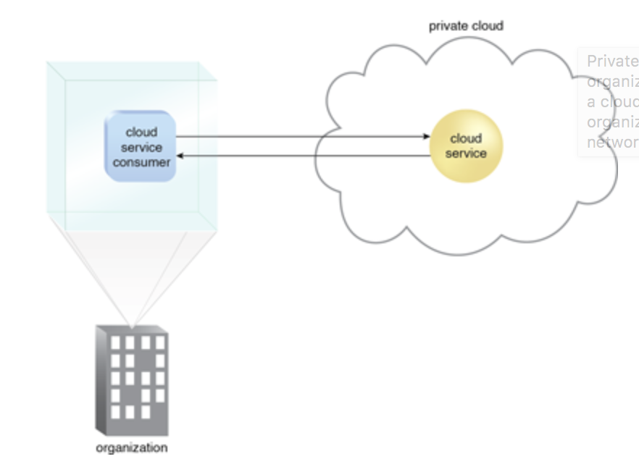
Private cloud
The cloud infrastructure is provisioned for exclusive use by a single organization comprising multiple consumers (e.g., business units). It may be owned, managed, and operated by the organization, a third party, or some combination of them, and it may exist on or off premises
Notes:
Pictures from: http://whatiscloud.com/cloud_deployment_models/private_clouds

Slide 21
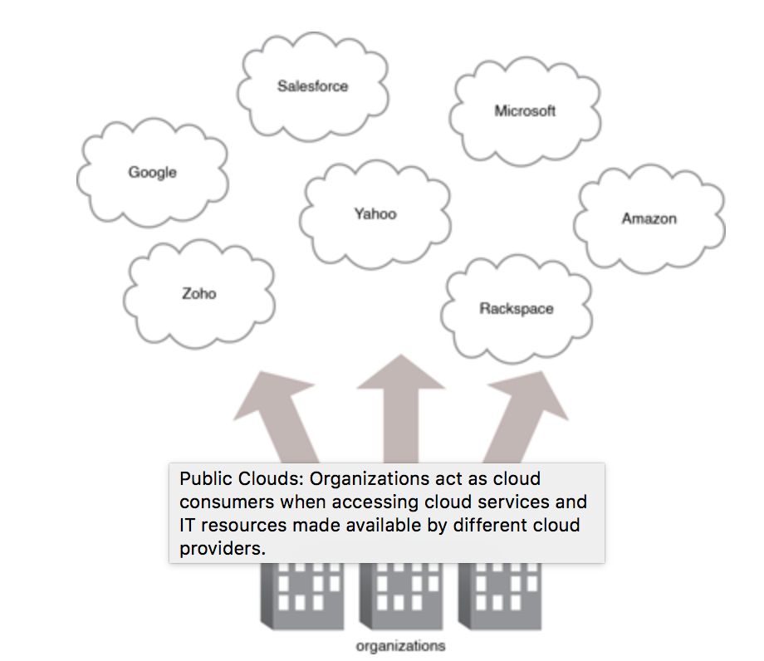
Public cloud
Public cloud: The cloud infrastructure is provisioned for open use by the general public. It may be owned, managed, and operated by a business, academic, or government organization, or some combination of them. It exists on the premises of the cloud provider

Slide 22
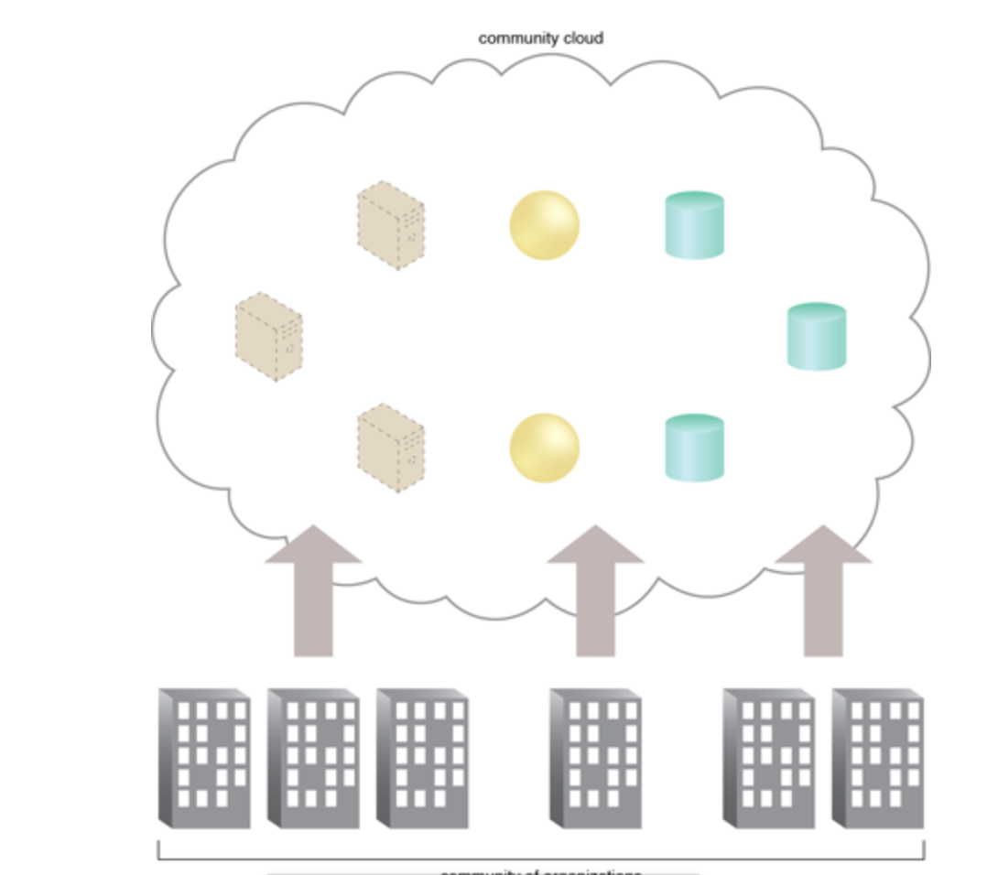
Community cloud
Community cloud: The cloud infrastructure is shared by several organizations and supports a specific community that has shared concerns. It may be managed by the organizations or a third party and may exist on premise or off premise

Slide 23
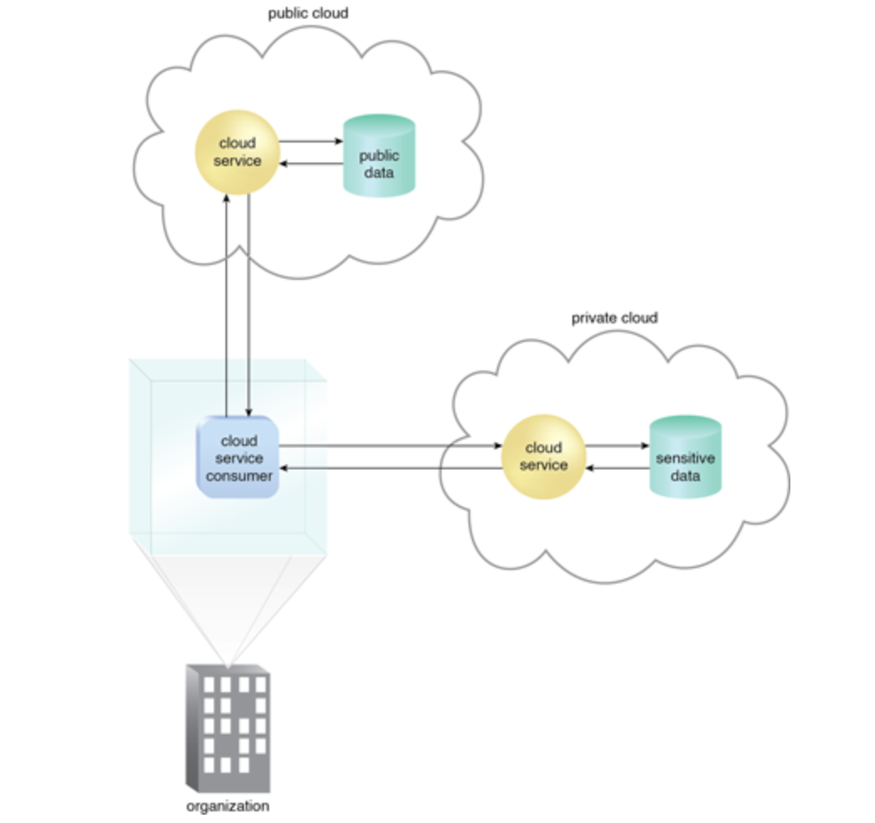
Hybrid cloud
The cloud infrastructure is a composition of two or more distinct cloud infrastructures (private, community, or public) that remain unique entities but are bound together by standardized or proprietary technology that enables data and application portability

Slide 24
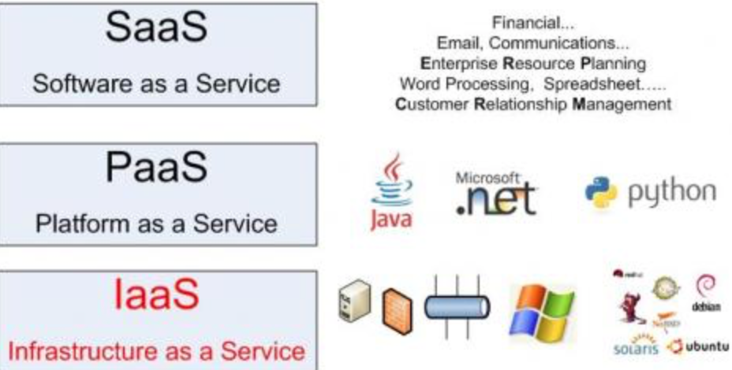
Three Service Offering Models
The three kinds of services with which the cloud-based computing resources are available to end customers are as follows:
Software as a Service (SaaS)
Platform as a Service (PaaS)
Infrastructure as a Service (IaaS).

Slide 25
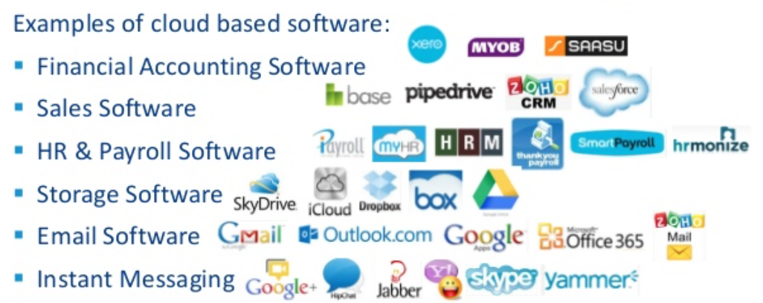
Cloud SaaS
The capability provided to the consumer is to use the provider’s applications running on a cloud infrastructure, including network, servers, operating systems, storage, and even individual application capabilities, with the possible exception of limited user-specific application configuration settings
Typical applications offered as a service include customer relationship management (CRM), business intelligence analytics, and online accounting software.

Slide 26
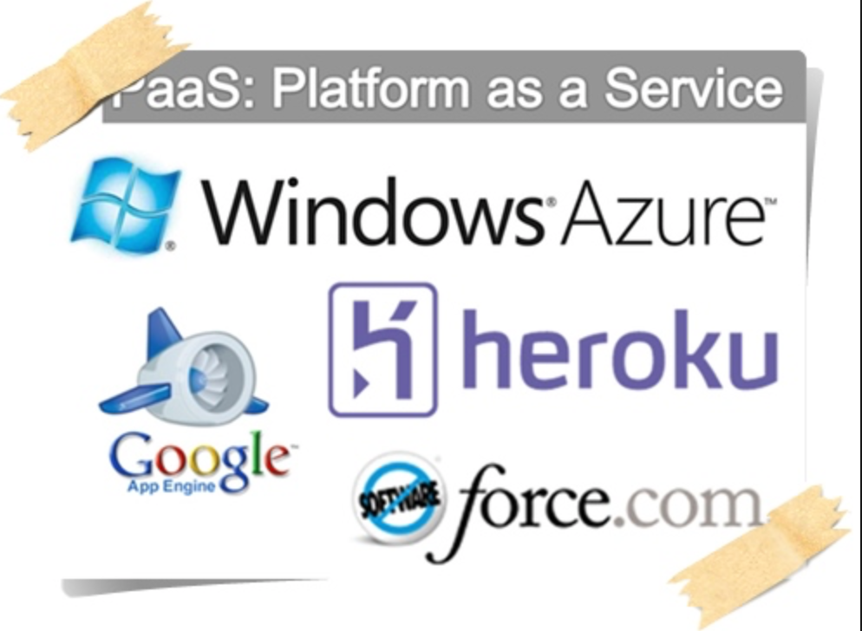
Cloud PaaS
Cloud PaaS: The capability provided to the consumer is to deploy onto the cloud infrastructure consumer-created or acquired applications created using programming languages, libraries, services, and tools supported by the provider

Slide 27
Cloud IaaS
Cloud IaaS: The capability provided to the consumer is to provision processing, storage, networks, and other fundamental computing resources on a pay-per-use basis where he or she is able to deploy and run arbitrary software, which can include operating systems and applications.
The consumer does not manage or control the underlying cloud infrastructure but has control over the operating systems, storage, and deployed applications and possibly limited control of select networking components

Slide 28
Recaps
Computing Paradigms
Cloud computing definition
Cloud computing essential characteristics
Cloud computing deployment models
Cloud computing service models

Slide 29
References
Client/server and peer-to-peer models: basic concepts (Dmitri Moltchanov September 04, 2013)

